Slide 1

Electronic Devices
Lab Lecture 1
This document might contain some excerpts and pictures from various books and other sources. The author doesn’t claim any rights to the topics discussed in this video. This topics has been presented in a way to help out students in BRAC university, Bangladesh

Slide 2
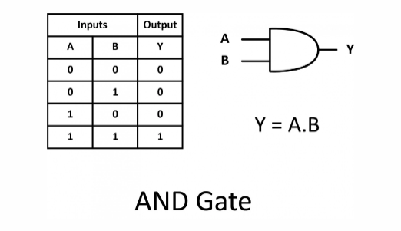
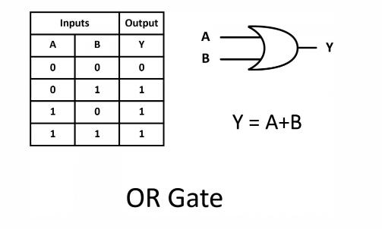
Diode Logic Gates

Slide 3
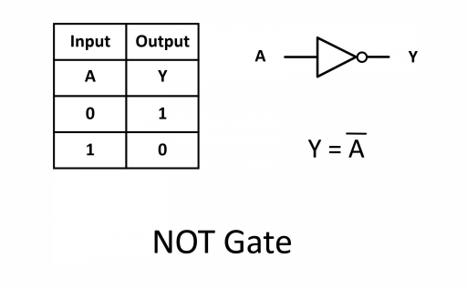
Diode Logic Gates

Slide 4
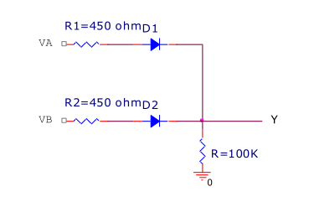
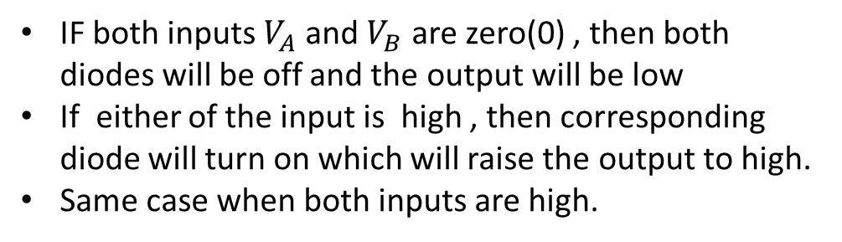
Diode Logic Gates
Diode logic means construction of Boolean logic gates from diodes
IF both inputs $V_{A}$and $V_{B}$ are zero(0) , then both diodes will be off and the output will be low
If either of the input is high , then corresponding diode will turn on which will raise the output to high.
Same case when both inputs are high.
Figure : Diode logic OR gate

Slide 5
Diode Logic Gates
Input A | Input B | Output Y
0 | 0 | Low
0 | 5(High) | High
5(High) | 0 | High
5(High) | 5(High) | High
Figure : Diode logic OR gate

Slide 6
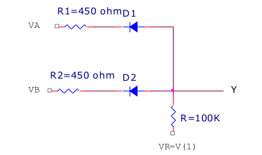
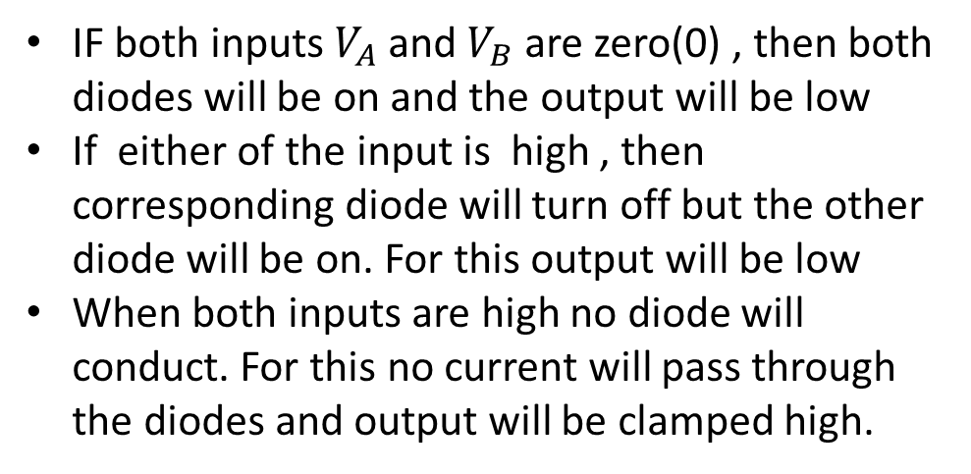
Diode Logic Gates
IF both inputs $V_{A}$and $V_{B}$ are zero(0) , then both diodes will be on and the output will be low
If either of the input is high , then corresponding diode will turn off but the other diode will be on. For this output will be low
When both inputs are high no diode will conduct. For this no current will pass through the diodes and output will be clamped high.
Figure : Diode logic AND gate

Slide 7
Diode Logic Gates
Input A | Input B | Output Y
0 | 0 | Low
0 | 5(High) | Low
5(High) | 0 | Low
5(High) | 5(High) | High
Figure : Diode logic AND gate

Slide 8
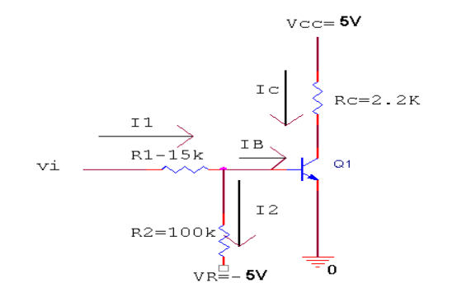
Diode Logic Gates
When the input is HIGH, the transistor will turn on. Both junctions of the transistor will be forward biased, as a result it will be in saturation mode. In saturation mode, the voltage between emitter and collector is close to 0 volt (~0.1 V) . So , output will be LOW when the input s high.
When the input is LOW , the transistor will be in cutoff mode ( because no current will be passing through the base) . So output will be HIGH.
Figure : Diode logic INVERTER

Slide 9
Diode Logic Gates
Input | Output Y
LOW | HIGH
HIGH | LOW
Figure : Diode logic INVERTER gate

Slide 10
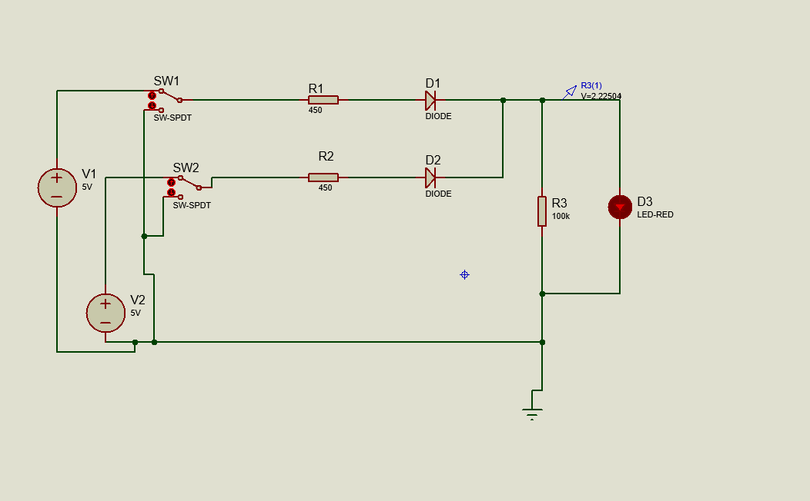
Simulation
Figure: Schematic of DL OR gate

Slide 11
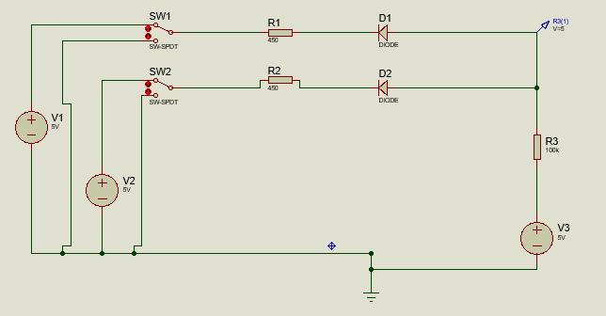
Simulation
Figure: Schematic of DL AND gate

Slide 12
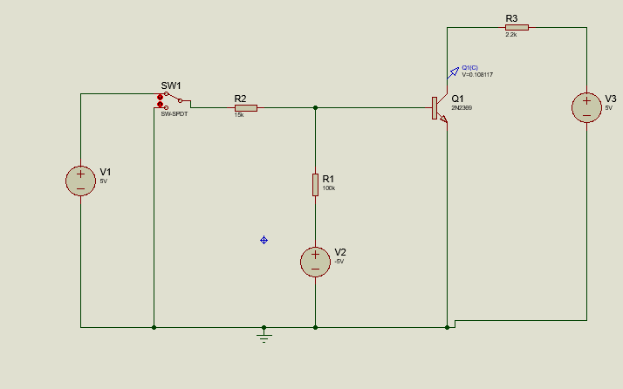
Simulation
Figure: Schematic of DL INVERTER gate

